Slide 1
Sustainability
and a Material Science & Engineering
T. Çağan ÖZKAYA and Servet TURAN

Slide 2
Sustainability ?

Slide 3
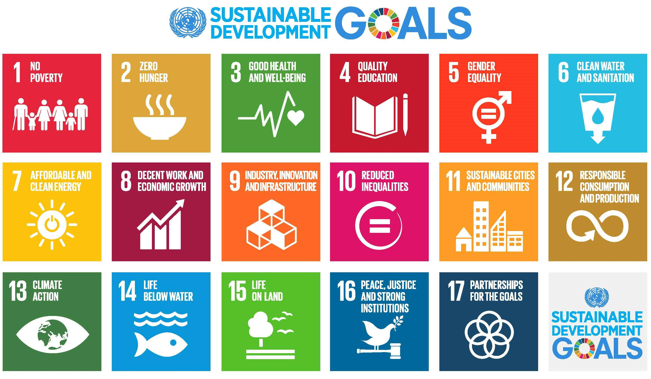

Slide 4
Some Words and Definitions About Sustainability
Environmental: Minimize impact, preserve resources, reduce emissions, promote renewables.
Social: Ensure equity, address inequalities, promote education, healthcare, and community engagement.
……
4…..

Slide 5
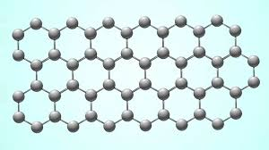
4. Carbon & Water Footprints

Slide 6
The carbon footprint
The water footprint

Slide 7
How Can We Calculate Our Individual Carbon Footprint?

Slide 8
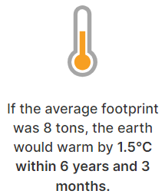
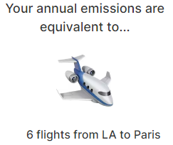
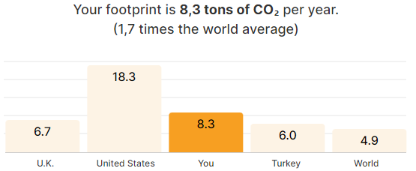
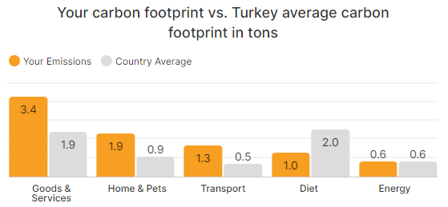
Many online calculators allow you to quickly and easily program your carbon footprint. These calculators usually request the following informations:
Country you live in
House type (apartment, detached house, etc.)
Energy consumption (electricity, natural gas, etc.)
Transportation preferences (car, public transportation, bicycle, etc.)
Meat consumption
Amount of waste
Buying furniture or clothes

Slide 9
How Can We Calculate Our Individual Water Footprint?

Slide 11
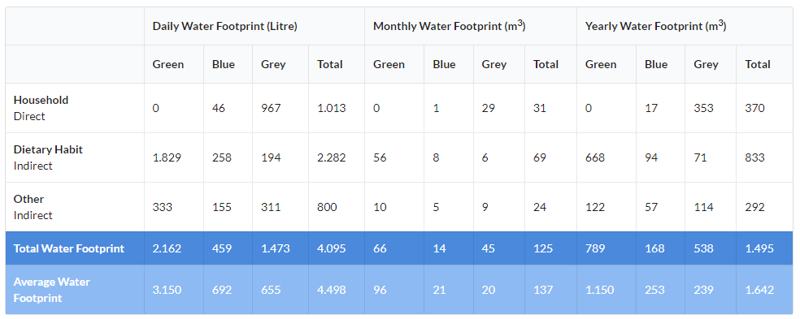

Slide 12
How Can We Reduce Our Individual Carbon & Water Footprints?

Slide 13
How Can We Reduce
Our Individual Carbon & Water Footprints?

Slide 14
How Can We Reduce
Our Individual Carbon & Water Footprints?

Slide 16
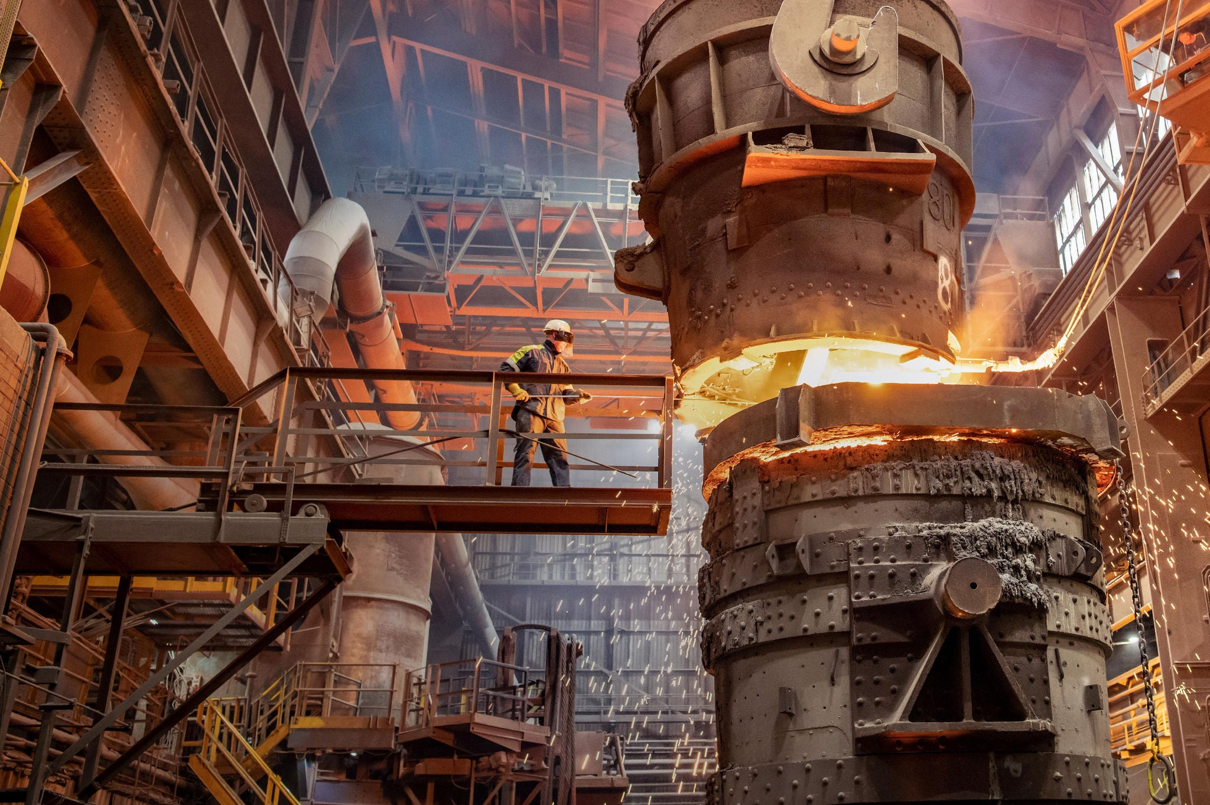
For Instance, Kardemir Karabük Iron and Steel Works,
Carbon Footprint Calculation:
Total Carbon Emissions: 5.5 million tons of CO2
Emission per Ton of Crude Steel: 2.50 tons of CO2 per TCS (Ton of Crude Steel)
Produced crude steel quantity: 3.62 million tons
Total carbon emissions = (Emission per Ton of Crude Steel) × (Produced crude steel quantity)
Total carbon emissions = 2.50 tons of CO2 per TCS × 3.62 million tons = 9.05 million tons of CO2

Slide 17
Water Footprint Calculation:
Freshwater consumption: 22.2 million m³
Wastewater quantity: 14,456,788 m³
Water usage per ton of crude steel: 7.9 m³ per TCS
Produced crude steel quantity: 3.62 million tons
Total water usage = Produced crude steel quantity × Water usage
Total water usage = 3.62 million tons × 7.9 m³ per TCS = 28,598,000 m³
Recycled waste quantity: 1,137,312 tons
Waste sent to disposal quantity: 158,771 tons
Recycling rate: 14.61%
Total waste quantity = Recycled waste quantity + Waste sent to disposal quantity
Total waste quantity = 1,137,312 tons + 158,771 tons = 1,296,083 tons
Amount of waste recycled = Total waste quantity × Recycling rate
Amount of waste recycled = 1,296,083 tons × 14.61% = 189,305 tons
The amount of water saved is considered equal to the amount of recycled waste.
Total water usage (net) = Total water usage - Amount of waste recycled
Total water usage (net) = 28,598,000 m³ - 189,305 tons = 28,408,695 m³
Calculated carbon footprint is 9.05 million tons of CO2, and its water footprint is 28,408,695 m³.

Slide 18
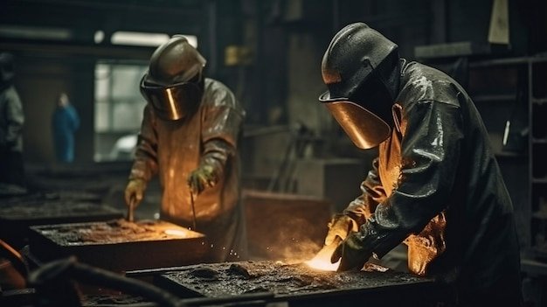
Carbon Footprint Reduction Ideas:
Energy Efficiency: Implement energy-efficient manufacturing processes, such as using more efficient furnaces, upgrading to energy-saving machinery, and optimizing energy use in the production line.
Waste Reduction: Implement waste reduction strategies, such as recycling scrap metals and using recycled materials in production, improving recycling processes for waste disposal.
Sustainable Sourcing: Source raw materials from sustainable sources, reducing the environmental impact of mining and processing.
Carbon Offsetting: Consider carbon offset programs to compensate for emissions that cannot be reduced.
Water Footprint Reduction Ideas:
Water Conservation: Use water-saving technologies, such as water recycling systems, water-efficient machinery, and optimizing water use in production processes.
Sustainable Water Sourcing: Source water from sustainable sources, reducing the environmental impact of water extraction and processing.
Water Recycling: Implement water recycling systems to reuse water within the production process, reducing the need for freshwater.
Water Footprint Accounting: Conduct water footprint accounting to understand the water consumption of the factory and its supply chain. This can help identify areas for improvement and ensure that water conservation efforts are effective.

Slide 19
As a Material Scientist What Can We Do ?

Slide 20
THANK YOU
SUSTAINABILITY:
Life Style for us all

